Slide 1
Cybersecurity Power Hour
DHS Color Palette Per OPA RGB Colors
Use Arial Font For All Text
Klint Walker
Region IV
Cybersecurity Advisor (CSA)
Change Presenter’s Name
In Slide Master
Notes:
Change Presenter’s Name and Date in Slide Master view.

Slide 2
Agenda
Who we are!
Threats and Trends
Teleconference Security
Supply Chain

Slide 4
Notes:
As part of CISA’s mission to lead the national effort to protect and enhance the resilience of the nation’s physical and cyber infrastructure, DHS coordinates with sector-specific agencies to oversee 16 critical infrastructure sectors.
CISA’s stakeholders/customers are:
Federal departments and agencies;
State, local, tribal, and territorial governments;
Critical infrastructure owners and operators; and
(to some extent) international entities.
80% of critical infrastructure is owned and/or operated by the private sector:
Voluntary partnerships (with a few exceptions)

Slide 6
Cyberspace: Foundational to Our World
Automation, technology, and network communications have become increasingly essential to our daily lives.
The amount of information and data stored electronically has grown.
There is a vast interconnectedness of relationships and dependencies, for example
government – private sector – international
third-party vendors
linkages within organizations
As a result, the country is dependent on the cyber resilience of its critical infrastructure, such as, the power grid, banking and financial systems, and telecommunications.

Slide 7
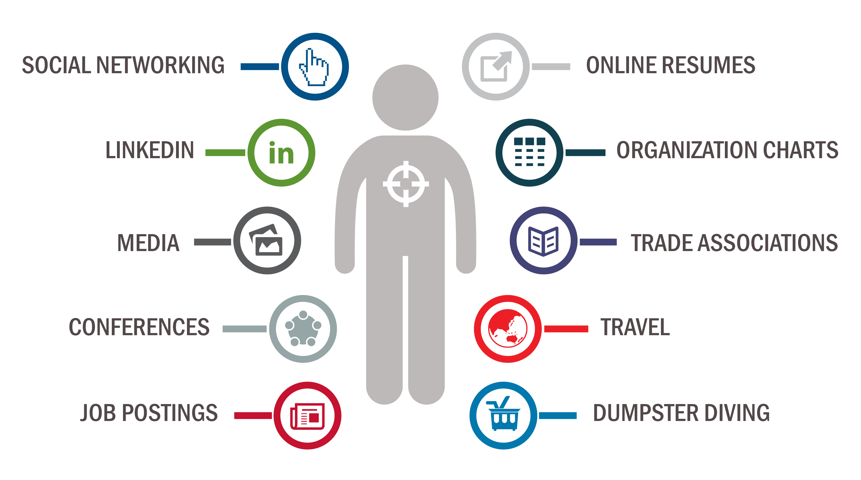
How Are You Targeted?
Notes:
Something for you PERSONNALY…Let’s start with the Human Factor….the bad guys are looking for PLACEMENT and ACCESS you have.
LinkedIn is #1. Can add stories/substances to some of these examples:
Conferences – People looking to relax with drinks, networking with strangers, intel officers will listen for gripes, cutbacks and other complaints. Do not take free USBs.
If someone is really interested in you…be careful. People asking for a second meeting is a tip off, a second meeting is critical for someone looking for intel.
Social networking (your picture helps bad guys find you as a target)
Travel (I added this) – people typically are not paying attention, you are stuck in a terminal or on a plane – DON’T work on sensitive information next to a person with a laptop on.
Posting resumes online, or other information: You this sports team.
Don’t click on bank or credit card or PayPal emails!

Slide 8
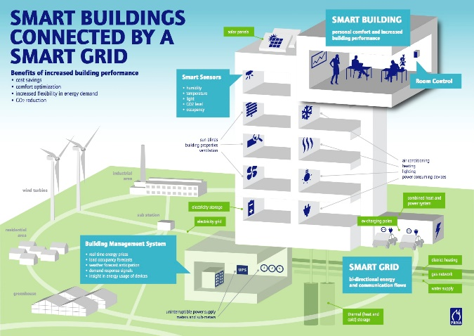
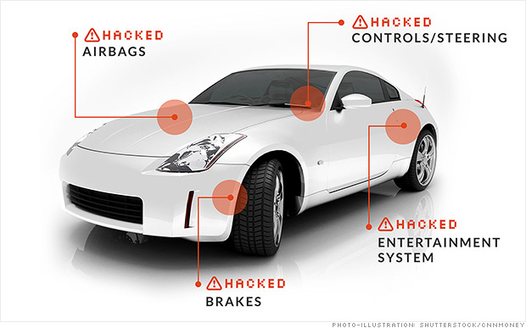
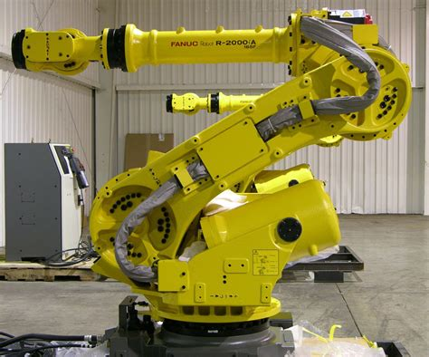
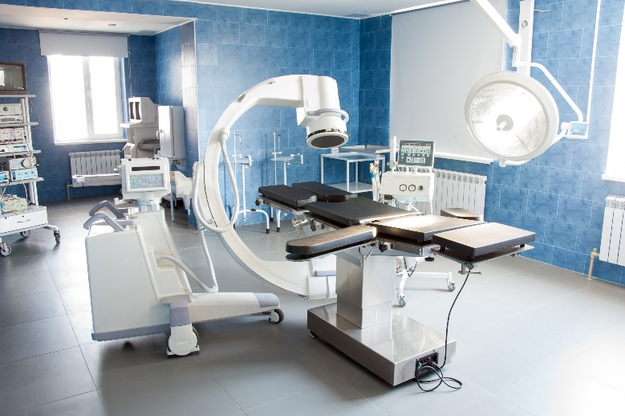
Cyber Security is Critical
Our buildings
Our transport
Smart cars, grids, medical devices, manufacturing, homes, buildings, smart everything!
We bet our lives on these systems
cyber security ⬄ physical safety!
Yet, much of CPS are “cobbled together from stuff found on the Web”!
Who minds the shop?
Our stuff
Our Production
Our health

Slide 9
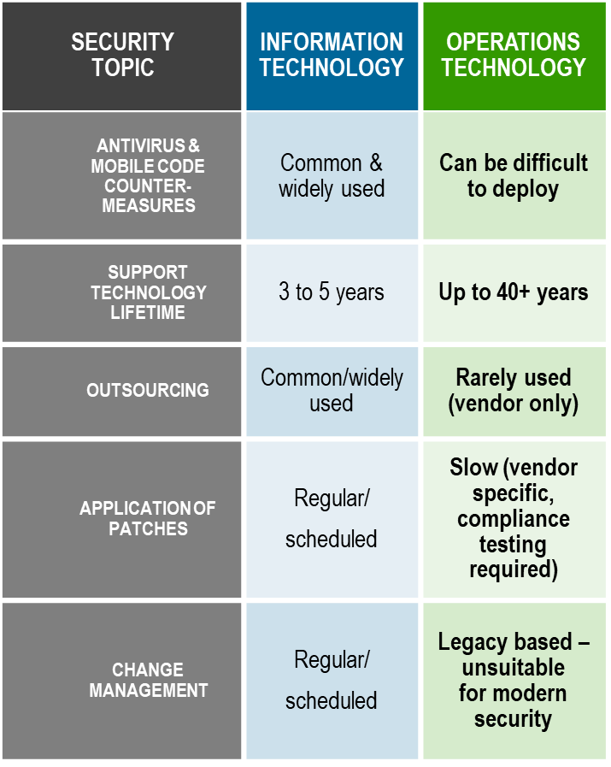
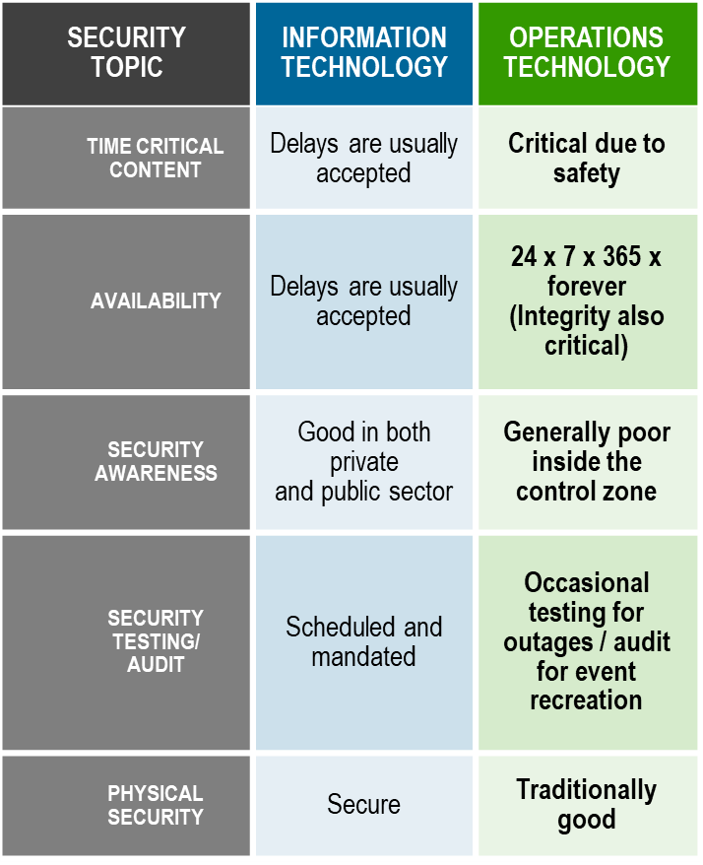
IT vs. OT

Slide 10
Teleconference Security
TIP 1: ONLY USE APPROVED TOOLS
Don’t install unapproved clients.
Ensure links are correct.
TIP 2: SECURE YOUR MEETING
Consider attendees.
Have a plan to terminate a meeting.
Secure private meetings.
Control attendees.
TIP 3: SECURE YOUR INFORMATION
Manage screensharing, recording, and file sharing options.
Protect sensitive information.
TIP 4: SECURE YOURSELF
Don’t reveal information unintentionally.
Consider your surroundings.
Check and update your home network.

Slide 11
Cyber Supply Chain
Cybersecurity in the supply chain cannot be viewed as an IT only problem.
Cyber supply chain risks include:
sourcing,
vendor management,
supply chain continuity and quality,
transportation security
and many other functions across the enterprise
Cybersecurity is never just a technology problem, it’s a people, processes and knowledge problem.
Require a coordinated effort to address.

Slide 12
Cyber Supply Chain Attack Examples
Target (2014) – HVAC security
Equifax – 3rd Party Software flaw
Verizon – Flawed Analytic software
Paradise Papers – Data hacked from legal firms
Domino’s Pizza (Australia) – former 3rd party database hacked
In a recent poll over 50 percent of organizations have had a breach that was caused by one of their vendors
Supply Chain Attacks Spiked 78 Percent in 2018, Cyber Researchers Found
Notes:
The industries most targeted by island hopping, the report said, are financial (47%), manufacturing (42%) and retail (32%).
Island Hopping is hacking a supply chain to jump from business to business to find the real target at the end
increasingly targeting valuable intellectual property (IP).

Slide 13
Cyber Supply Chain Threats
Software service providers and outside contractors
exploitation of smaller, typically less-secure companies who have access to or credentials for the networks of larger corporations
Mergers and acquisitions
Inheriting the (lack of) security for smaller companies
Physical components
hidden “backdoors” embedded in software or hardware
Network services
Do you know the route your digital traffic takes from one point to the next?
IOT (internet of things)
prioritize time-to-market over security

Slide 14
Sampling of Cybersecurity Offerings
Preparedness Activities
Information / Threat Indicator Sharing
Cybersecurity Training and Awareness
Cyber Exercises and “Playbooks”
National Cyber Awareness System
Vulnerability Notes Database
Information Products and Recommended Practices
Cybersecurity Evaluations
Cyber Resilience Reviews (CRR™)
Cyber Infrastructure Surveys
Phishing Campaign Assessment
Vulnerability Scanning
Risk and Vulnerability Assessments (aka “Pen” Tests)
External Dependency Management Reviews
Cyber Security Evaluation Tool (CSET™)
Validated Architecture Design Review (VADR)
Response Assistance
Remote / On-Site Assistance
Malware Analysis
Hunt and Incident Response Teams
Incident Coordination
Cybersecurity Advisors
Assessments
Working group collaboration
Best Practices private-public
Incident assistance coordination
Protective Security Advisors
Assessments
Incident liaisons between government and private sector
Support for National Special Security Events
Notes:
Speaker notes needed by a CSA. Original slide notes: ALT Slide- general narrative on this one is “Left of “BOOM”, right of “BOOM”, where boom= incident.

Slide 15
Range of Cybersecurity Assessments
Cyber Resilience Review (Strategic)
External Dependencies Management (Strategic)
Cyber Infrastructure Survey (Strategic)
Cybersecurity Evaluations Tool Strategic/Technical)
Phishing Campaign Assessment (EVERYONE)
Vulnerability Scanning / Hygiene (Technical)
Validated Architecture Design Review (Technical)
Risk and Vulnerability Assessment (Technical)
TECHNICAL
(Network-Administrator Level)

Slide 16
For more information:
www.cisa.gov
CSA Program
Email: cyberadvisor@hq.dhs.gov
Phone: 404-895-1127

