Slide 1

Securing the Future of Work
Nicole Eagan
Co-Founder, Chief Strategy & AI Officer

Slide 2
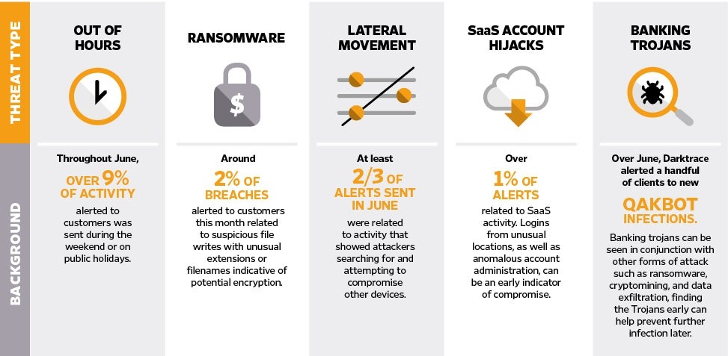
What We Learned
OVER 9% OF ACTIVITY
2% OF BREACHES
NUMEROUS ALERTS
2/3 OF ALERTS SENT
QUAKBOT INFECTIONS.
Notes:
TAKEN FROM WIRED ARTICLE – SAME DATA AS IN PREVIOUS SLIDE JUST DIFFERENT LAYOUT

Slide 3
Rapid Adoption of Digital Collaboration
Less than 1/3 of businesses are monitoring abnormal workforce behavior across their cloud footprint. This is alarming considering the significant increase in usage of cloud apps and collaboration platforms.
- Cybersecurity Insiders
Notes:
We know that at this time, your workforce is using a number of different SaaS applications. In many cases, these activities and data are relatively unprotected, bringing fresh challenges to security teams.
The reality is that today’s workforce is dispersed, dynamic, and fundamentally unpredictable – making it harder for security teams to keep track of what devices are on their corporate network, and how users are operating in SaaS applications.
The move to remote working has made this exponentially more difficult, with many organizations having transitioned to a full SaaS working model overnight, making it even harder to identify threats.
Added to this user behaviors are constantly changing, and the merging of applications across both home and work devices has led to increased threat
Many tools fall back on the traditional paradigm of a network perimeter when discussing protection, but this way of thinking is obsolete.
Coverage of the whole environment is needed.
Many SaaS providers have been helping companies navigate the shift to remote working
But, protecting the digital workforce in SaaS and cloud environments is new and unfamiliar territory for traditional security teams
As a recent cybersecurity insiders report has shown, less than 1/3 of businesses are monitoring abnormal workforce behaviour across their cloud footprint.
Lack of visibility is a key issue facing many organizations

Slide 4


The Dynamic Workforce
Digital transformation projects are being accelerated
Fluid working environments and hours are here to stay
Fragmented, staggered return to offices
Employees may bring malware and vulnerabilities with them or inadvertently use unapproved technology
Low-lying cyber-criminals thriving on disruption and change
Notes:
We know that at this time, your workforce is using a number of different SaaS applications. In many cases, these activities and data are relatively unprotected, bringing fresh challenges to security teams.
The reality is that today’s workforce is dispersed, dynamic, and fundamentally unpredictable – making it harder for security teams to keep track of what devices are on their corporate network, and how users are operating in SaaS applications.
The move to remote working has made this exponentially more difficult, with many organizations having transitioned to a full SaaS working model overnight, making it even harder to identify threats.
Added to this user behaviors are constantly changing, and the merging of applications across both home and work devices has led to increased threat
Many tools fall back on the traditional paradigm of a network perimeter when discussing protection, but this way of thinking is obsolete.
Coverage of the whole environment is needed.
Many SaaS providers have been helping companies navigate the shift to remote working
But, protecting the digital workforce in SaaS and cloud environments is new and unfamiliar territory for traditional security teams
As a recent cybersecurity insiders report has shown, less than 1/3 of businesses are monitoring abnormal workforce behaviour across their cloud footprint.
Lack of visibility is a key issue facing many organizations

Slide 5
AI Adapted to New Patterns of Work
Learned employees’ new normal at speed and scale
Holistic and consistent protection providing peace of mind
Streamlining of security teams’ workflow
Autonomous detection, investigation and response capabilities allow humans to focus on strategic tasks
Dynamic understanding of ‘threatening’ activity
Notes:
AI did so well in the transition out of work; it learned at speed with the immediate transition that so many faced, with a 24 hour change; that’s what you need for a dynamic workforce
Saving time at times of heightened anxiety and distraction the AI, specifically AIA and AGN/AGE just provide protection and do the work
Natural bridge into “you can’t enforce normal business ops in a time of chaos unless the tech knows what it is – imagine if the AI can enforce the normal business operations. Understands when something is going off the rails (intro Autonomous Response w/o calling it such).
Here we can highlight how this peace of mind also helps enables innovation

Slide 6

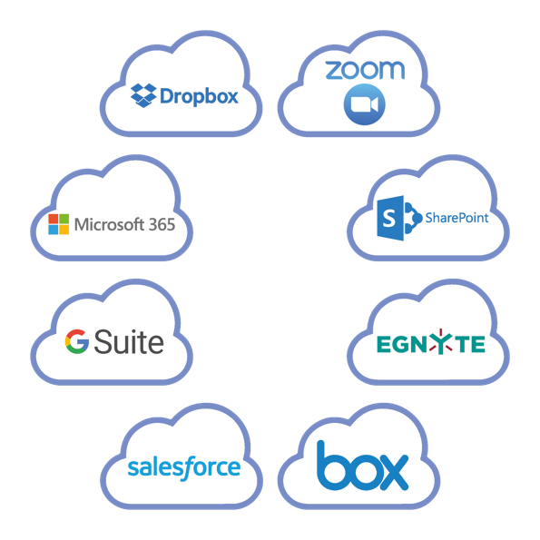
Cyber AI for the Dynamic Workforce
Visibility into endpoints, email and SaaS environments
Contextual understanding across entire digital organization
Detects full range of threats – from account takeover and malicious insiders, to critical misconfigurations
Autonomously investigates and responds to attacks – wherever they are
Notes:
Darktrace’s new SaaS module is compatible with all major cloud providers and SaaS applications, requiring no pre-input or configuration
This development includes a new User Interface for our extended SaaS coverage, SaaS-specific AI models and a new software developer’s Kit that enables your security team to create additional SaaS modules to be increasingly tailored to your own environment.
Founded on our immune system approach, Darktrace’s AI for SaaS is adaptive to each organization’s bespoke environment, learning ‘self’ on the job – no matter where that job is
This is complimented by flexible coverage, with customizable deployments available
Unlike traditional tools, Darktrace provides a unified view of workforce behaviour, not only across cloud and SaaS, but in all aspects of your digital environments. No other solution can analyze and understand the dynamic patterns of life that cut across email, cloud, and the corporate network for unified detection and response
Such a contextual understanding of users across all their digital environments which only Darktrace can provide means the most subtle signals of threat can be detected and neutralized
And through Darktrace’s self-learning AI continuously evolving its sense of self, its understanding of legitimate activity is always current
This enterprise-wide understanding enables Darktrace’s AI to stitch together seemingly disparate events into a cohesive narrative, allowing you to see that unremarkable behavior viewed in isolation may point to a greater picture of malicious activity.
- The most common and dangerous risks in SaaS environments are compromised credentials and insider threat. These are precisely the kinds of threats that evade static defenses, as they require a multi-dimensional understanding of how workers interact with services and consume data, which Darktrace provides.
- You will notice the logos on this slide. These are just a few of the SaaS products we cover.

Slide 7
Cyber AI for Email
Learns ‘self’ to identify malicious emails
Treats each user as a dynamic individual – not just an email address
Creates evolving ‘pattern of life’ for individuals and peer groups
Detects full range of email threats:
  social engineering
  business email compromise
  data loss
  spear phishing
When Antigena Email caught a spear phishing campaign that the Leader in the Gartner Magic Quadrant missed, we were convinced.
- CIO, Numeris
Notes:
Antigena Email
And we’ve applied this unique immune system approach to email security, with Antigena Email.
Antigena Email uses Darktrace’s core artificial intelligence to learn a unique sense of ‘self’ for your email communications – understanding what is ‘normal’ for every internal user, every external sender, and all the complex relationships between them.
By continuously analyzing behaviors and relationships across lateral, inbound, and outbound email traffic, Antigena Email spots subtle deviations that reveal seemingly benign emails to be unmistakably malicious. And again this analysis treats recipients as dynamic individuals and peers, not mere email addresses, and furnishes the multi-dimensional context needed to illuminate the subtle signs of an advanced email attack.
And it helps to think of Antigena Email and other defenses as simply asking different questions: while traditional defenses can only ask whether elements of an email have been observed in historical attacks – which is a fairly straightforward question to answer – Antigena Email is the only solution that can intelligently ask whether it would be abnormal for a recipient to receive / send / interact with a given email in the context of their normal ‘patterns of life’, as well as that of their peers and the wider organization, including relevant activity in their SaaS usage.
This contextual attunement to evolving ‘patterns of life’ enables the AI to make highly accurate decisions and neutralize attacks that evade the email gateway.
And because the technology is self-learning, it can detect the full range of advanced email attacks – so social engineering, spear-phishing, compromised email credentials, external data loss and spoofing attacks.

Slide 8
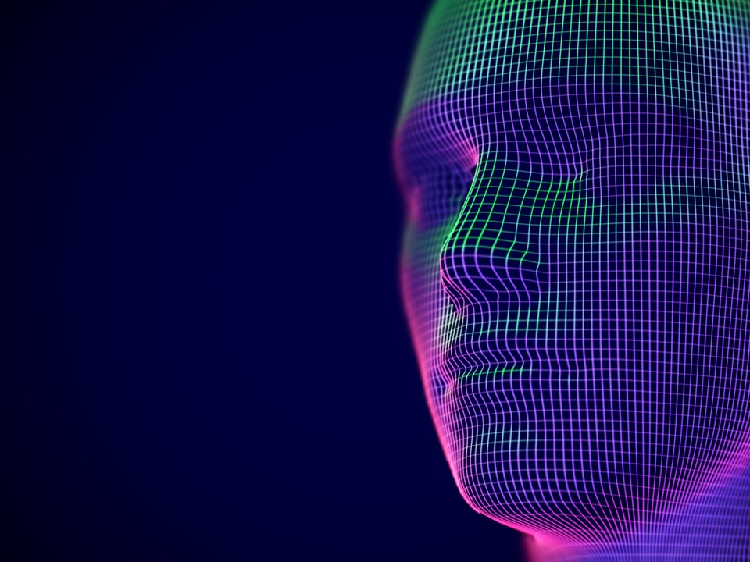
AI Analyst: Saving Crucial Time
Goes beyond autonomous threat detection to understand the threat, mimicking a human hypothesis, and making sense of what has been found
Automates cyber-threat investigation and interpretation
Continuously investigates all threats
Reduces triaging time by up to 92%

Slide 9
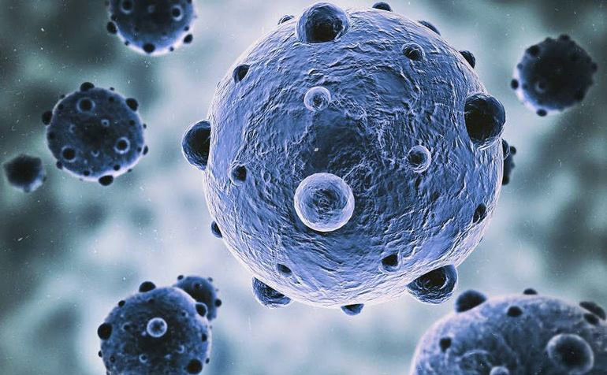
Fighting Back: Autonomous Response
Autonomous, surgical interruption of attacks
Reacts faster than human teams
No impact on normal, legitimate activity – business as usual
Improves functionality of other tools in a SOC
Frees up human teams to focus on what matters
Responds to a threat every three seconds
Antigena can autonomously and precisely contain in-progress attacks. Darktrace is fundamentally transforming how we defend our systems.
- Layton Construction
You can't bring a human to a machine fight
Notes:
Antigena is the AI decision-making engine that makes recommendations and takes precise actions, minimizing the impact of security incidents in seconds.
The next generation of cyber AI is for machines to fight back autonomously against fast-moving attacks.
We launched this capability four years ago, and today 1,000 of our customers now rely on Antigena on a daily basis to fight back against attacks.
What is so critical about Autonomous Response technology is that it generates a surgical and proportionate response to interrupt emerging threats, without impacting the rest of the business. This is because it understands what activity is normal, and what is highly threatening.
For instance, Antigena stops fast-moving malware from making connections with a specific file share, but the device it’s operating on is still able to function as it normally would, and the user is not disrupted. So it’s business as usual.
Antigena is also fully configurable – it can be turned on 24/7, or just when your teams are not present, such as at nights or on weekends. Or it can be used to go after specific kinds of threats, like ransomware.
As we’ve mentioned, there are four Antigena modules – this allows you to protect different areas of your infrastructure: cloud, endpoint, network, and email.
I have to say, the one area where everyone turns it on is the email environment.
Just briefly on this – you are no doubt already aware that the vast majority of attacks still come in through email (about 90%), and it’s becoming increasingly difficult to distinguish genuine emails from malicious ones.
Antigena Email really is a gamechanger when it comes to detecting even the most subtle email threats – and it consistently catches advanced phishing emails attacks better and faster than Microsoft.
The reason for this is that Antigena Email, as with the other modules, uses all of the rich intelligence it has learnt from the entirety of the digital environment – everything the Enterprise
Immune System has learnt – and uses that context when analyzing threats in the email environment. That’s why it’s so effective in stopping the malicious emails that legacy tools let in.
So Autonomous Response technology is unique. No one else can do this, and it is of course an increasingly critical capability as machine-speed attacks are fast becoming the norm.

Slide 10
